Slide 1
Nail Salon Management System
(Deliverable 1: Planning Phase)
Thomas Zhang, Derek Luong, Asad Khan, Hamza Mir, Spencer Wilkins, Salman Khan

Slide 2
Problem?
Ann is a small business owner that runs two nail salons. She uses a system of data organization that is outdated, lacks certain features, and constantly crashes. Our job is to create a new system that can address these issues by creating a new system that can better organize and maintain customer information and add new features that the old system didn’t have.

Slide 3
Project Overview
Requirements
Creation of a database using SQL oracle that is able to organize customer information name, age, address, etc. and will be able to keep track of customer transactions along with warranty information.
Ability for Customer to book appointments with nail tech, pay for the service, and purchase gift card directly on the website.
Creation of web application using HTML/PHP that will represent and specify details relating to the business such as opening/closing times and the business address.
Creation of a link between the web app and the database. This will allow the customers to access this site and create an account that will offer certain benefits.
Using transaction information create a customer reward system that keep track of customer reward point and spending.

Slide 4
Roles
Derek Luong - Business Analyst/App Developer
Asad Khan - Application Developer
Thomas Zhang - Project Manager/DB Developer
Spencer Wilkins - Database Administrator
Salman Khan - System Analyst
Hamza Mir - Quality Assurance

Slide 5
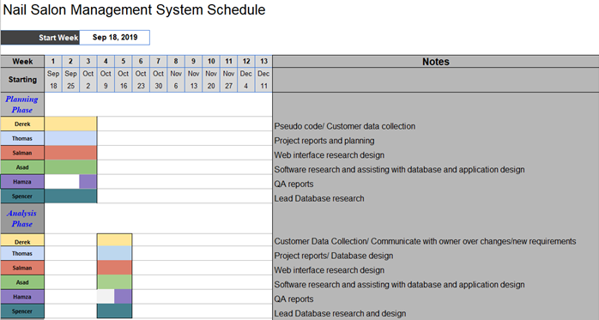
Project Plan (Planning Phase to Analysis Phase)
Planning Phase Goals:
Complete research on what software to use regarding database and web app
Establish meeting schedule and communication
Define clear roles
Plan key features of management system based of realistic completion based on time constraints

Slide 6
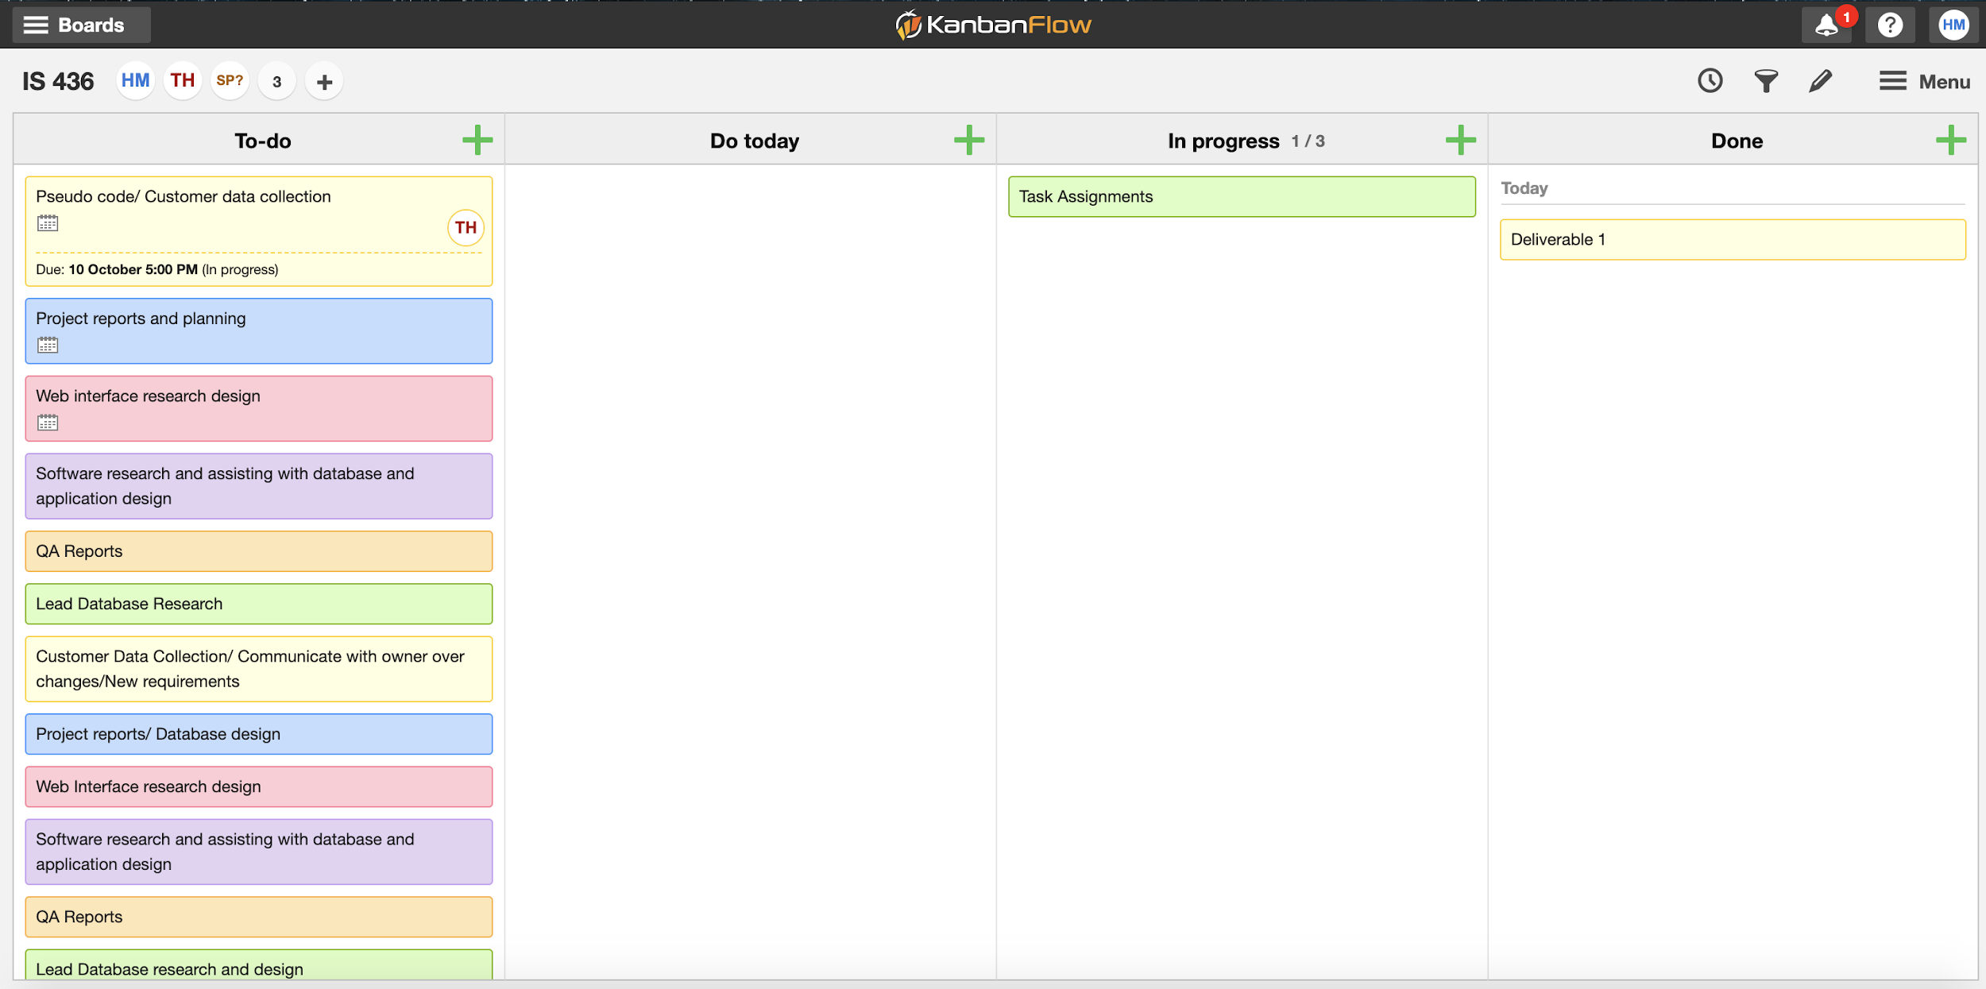

Slide 7
Feasibility Analysis: Technical Feasibility
Time Constraints
Familiarity with software needed to create database, web application and establish link (sql oracle, javascript, css, html, php etc.)
Difficulty with linking database to web application, lack of knowledge on software

Slide 8
Feasibility Analysis: Economic Feasibility
Budget - The owner agree to pay from $40,000 for the application if it included all the functions and features she has listed. Project cannot exceed this cost. The cost of this project will be taken in consideration from the following
Services/equipment - $28,000
Risk factors - $8,000
Miscellaneous - $4,000

Slide 9
Feasibility Analysis: Organizational Feasibility
Temporary or permanent replacement of staff for position in case of sickness or resignation of staff.

Slide 10
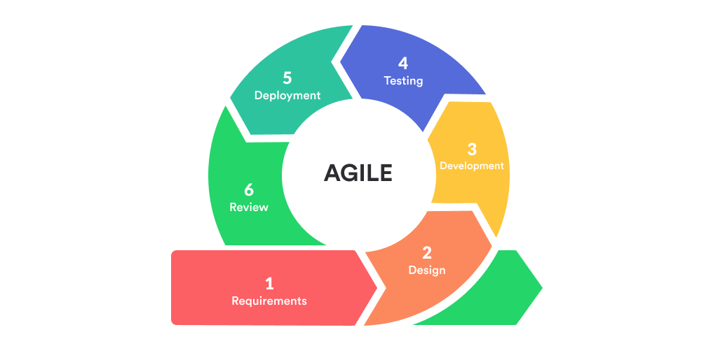
Agile Methodology

Slide 11
Questions?
https://github.com/tzhang490/IS-436.git

